Slide 1
One-Dimensional Non-Continuous Motion
Dr. Jacob Moore
Associate Professor of Engineering
Penn State Mont Alto

Slide 2




Non-Continuous Motion
Often a single mathematical function cannot describe the entirety of a problem.
This is called non-continuous motion.
ex: a car accelerates at a constant rate, holds a steady speed for a few seconds, then decelerates at a constant rate.
Ⅰ
Ⅱ
Ⅲ
$$v\left(t\right)$$
$$v\left(t\right)$$
$$v\left(t\right)$$
Velocity
(m/s)
Time
(s)

Slide 3
Non-Continuous Motion
To map out the velocity over time we would need to employ three mathematical expressions.
One for the first few seconds
A second for the next few seconds
A third for the final few seconds
Ⅰ
Ⅱ
Ⅲ
$$v\left(t\right)$$
$$v\left(t\right)$$
$$v\left(t\right)$$
Velocity
(m/s)
Time
(s)

Slide 4
Non-Continuous Motion
Using a graph or data at key points, we can often figure out the equations for each of these three sections.
In addition to the velocity function though, we may also be interested in the acceleration over time or the position over time.
Ⅰ
Ⅱ
Ⅲ
$$v\left(t\right)$$
$$v\left(t\right)$$
$$v\left(t\right)$$
Velocity
(m/s)
Time
(s)

Slide 5
Analyzing Non-Continuous Motion
To analyze non-continuous motion, start by drawing out a graph of position, velocity, or acceleration.
Sometimes this will be given to you, other times you will need deduce what the plot will be from the given information.
Draw everything you know, including the general shapes, equations, and labeling any key points.
Label each section that will require a separate set of equations (I like to use Roman numerals)

Slide 6
Analyzing Non-Continuous Motion
Once we have a graph of one thing (in this case acceleration) we will be taking derivatives or integrals to find the equations for the other plots.
Find the equation for the first section just as you would for a continuous function.
For the second section onward, we will get constants of integration when we integrate that will not necessarily be obvious.

Slide 7
Solving For the Constants of Integration
What helps us solve for the constants of integration is the continuity of the velocity and the position.
We can’t instantly change position or velocity, as that would require infinite acceleration.
If we solve for the velocity or position at the end of one section, it will be the same at the beginning of the next section.
This results also results in velocity graphs that are continuous and position graphs that are continuous without any sudden changes in slope.

Slide 8
Ⅰ
Ⅱ
Ⅲ
Acceleration
(m/s²)
Time
(s)
Velocity
(m/s)
Time
(s)
Position
(m)
Time
(s)

Slide 9
Thanks for Watching
See other engineering mechanics videos and access the full tool at…

Slide 10

Worked Example
A car accelerates from rest at a rate of 10 m/s² for 10 seconds. The car then immediately begins decelerating at a rate of 4 m/s² for another 25 seconds before coming to a stop. Find the equations for the acceleration, velocity, and position functions over the full 35 second time period and plot these functions.

Slide 11
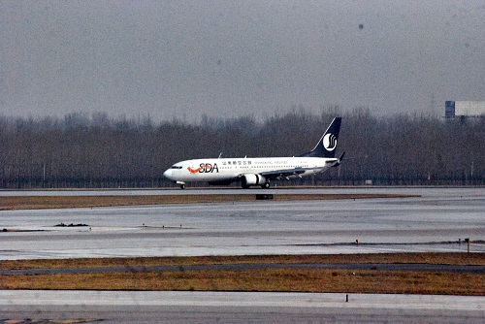
Worked Example
A plane with an initial speed of 95 m/s touches down on a runway. For the first second the plane rolls without decelerating. For the next 5 seconds reverse thrust is applied, decelerating the plane at a rate of 4 m/s². Finally, the brakes are applied with reverse thrust increasing the rate of deceleration to 8 m/s². How long does it take for the plane to come to a complete stop? How far does the plane travel before coming to a complete stop?

Slide 12

Worked Example
A satellite records the velocity function shown below over a sixty second time period. During that same time period determine the acceleration and position functions and draw these functions on a plot.
v(t) = 30t -150
v(t) = 1.5t²
Velocity
(m/s)
Time
(s)
10 s
60 s

